Slide 1

Analysis of Food Consumption Patterns and Nutritional Intake
Applied Data Science
Kalyan Pothineni
08/09/2024

Slide 2
Introduction
This project focuses on assessing food intake frequency and nutritional profiles across different population subgroups.
Understanding dietary patterns is crucial for public health as it helps in identifying nutritional gaps and opportunities for improvement.
We aim to uncover trends that can inform policy decisions and public health programs.

Slide 3
Background
Food intake and nutritional status have been key areas of concern for health practitioners and policymakers.
The relationship between diet and chronic disease has been well documented.
With new data and analytical tools, we can now provide more detailed insights into food consumption patterns.

Slide 4
Business Problem
Our goal is to analyze how dietary habits impact the general public’s health.
By studying food consumption and nutritional habits across diverse groups, we can identify problem areas and support public health programs in addressing these gaps.
Analysis to provide actionable insights for nutritionists and policymakers.

Slide 5
Data Sources
We used five datasets containing detailed information on food consumption, nutritional values, demographics, historical trends, and regional variations.
Key Data Columns:
food_id: Unique identifier for each food item.
consumption_rate: Rate at which each food item is consumed.
calories, protein, fat, carbohydrate: Nutritional values of each food item.
age_group, gender: Demographic information.

Slide 6
Data Preparation
Data Cleaning: Addressed missing values and outliers to ensure data quality.
Data Transformation: Normalized and standardized data for analysis consistency.
Data Integration: Combined multiple datasets for a comprehensive analysis.
Challenges included managing large datasets and ensuring data consistency across different sources.

Slide 7
Methods Overview
Exploratory Data Analysis (EDA): To understand basic patterns in the data.
Statistical Analysis: Identified trends and relationships in the data.
Time Series Analysis: Examined historical trends in food consumption.
Clustering and Segmentation: Grouped similar demographic groups based on their eating habits.
Predictive Modeling: Developed models to forecast future health impacts based on current nutritional data.

Slide 8
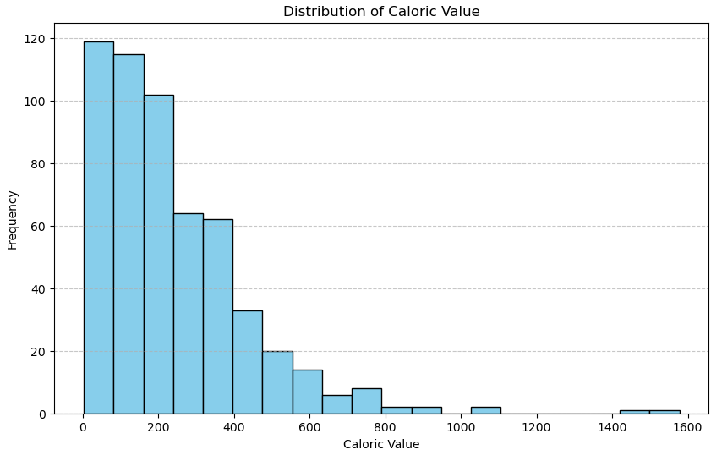
Exploratory Data Analysis
The histogram shows the distribution of calorie intake across different food items.
This helps us understand which foods are most consumed and their nutritional impact.

Slide 9
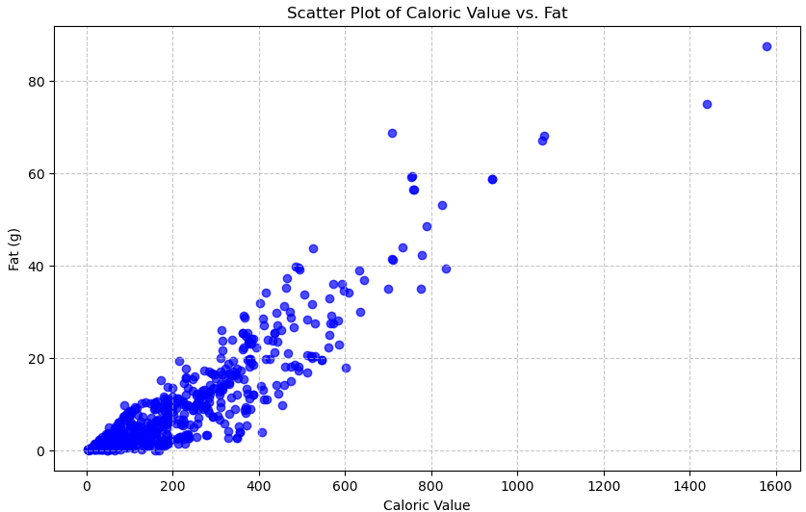
Correlation Analysis
The scatter plot reveals a strong positive correlation between caloric value and fat content.

Slide 10
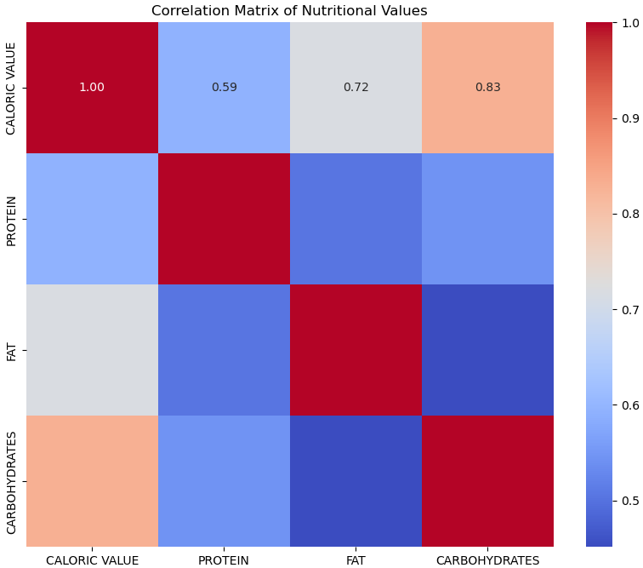
Correlation Analysis
The heatmap shows the relationships between various nutritional components like protein, fat, and carbohydrates.

Slide 11
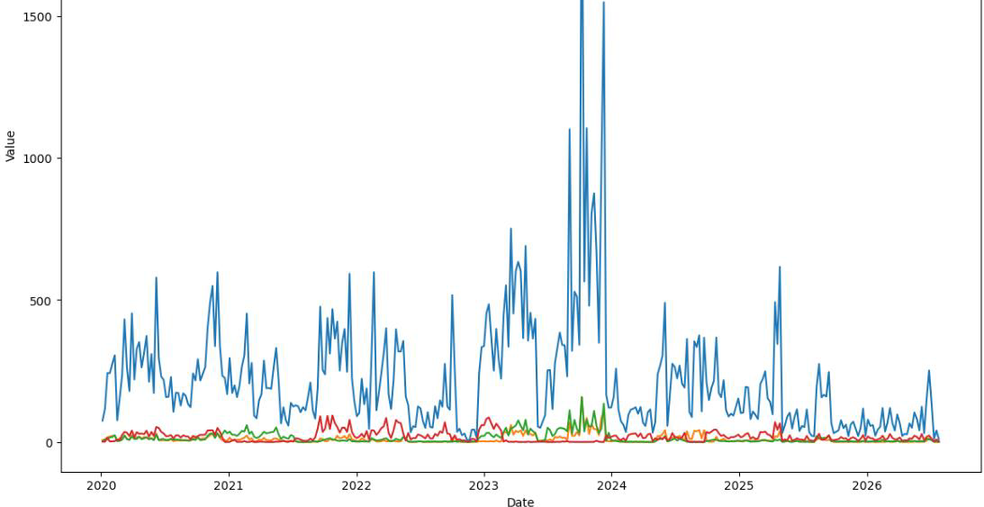
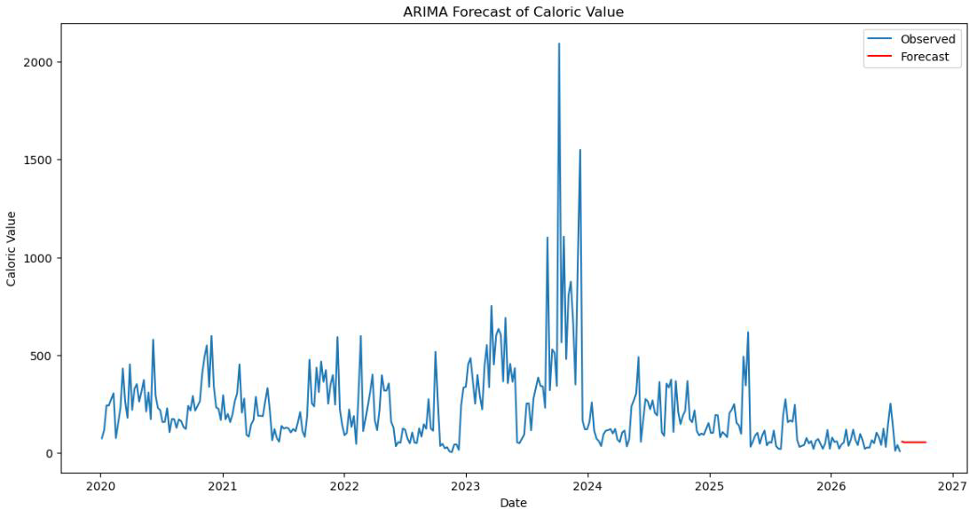
Time Series Analysis
Seasonal decomposition highlights patterns in food consumption over time.
ARIMA forecast predicts future trends in caloric intake.

Slide 12
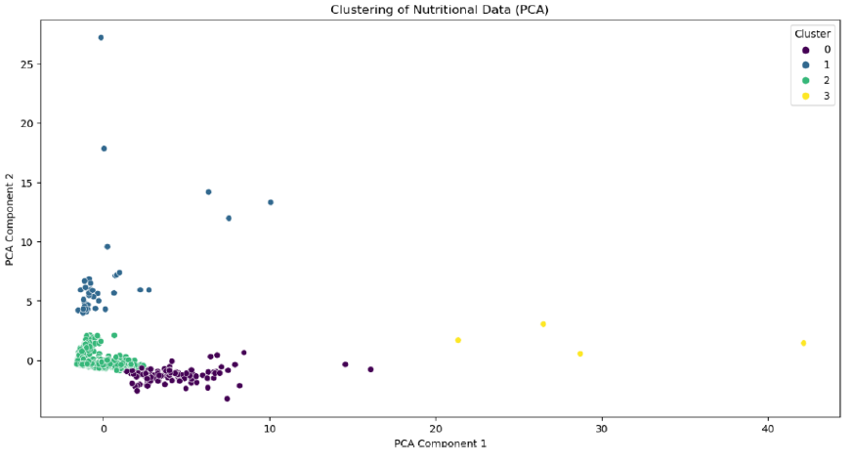
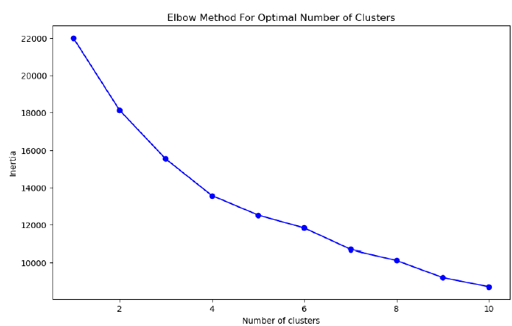
Clustering Analysis
Clustering analysis groups similar demographic groups based on their food consumption patterns.

Slide 13
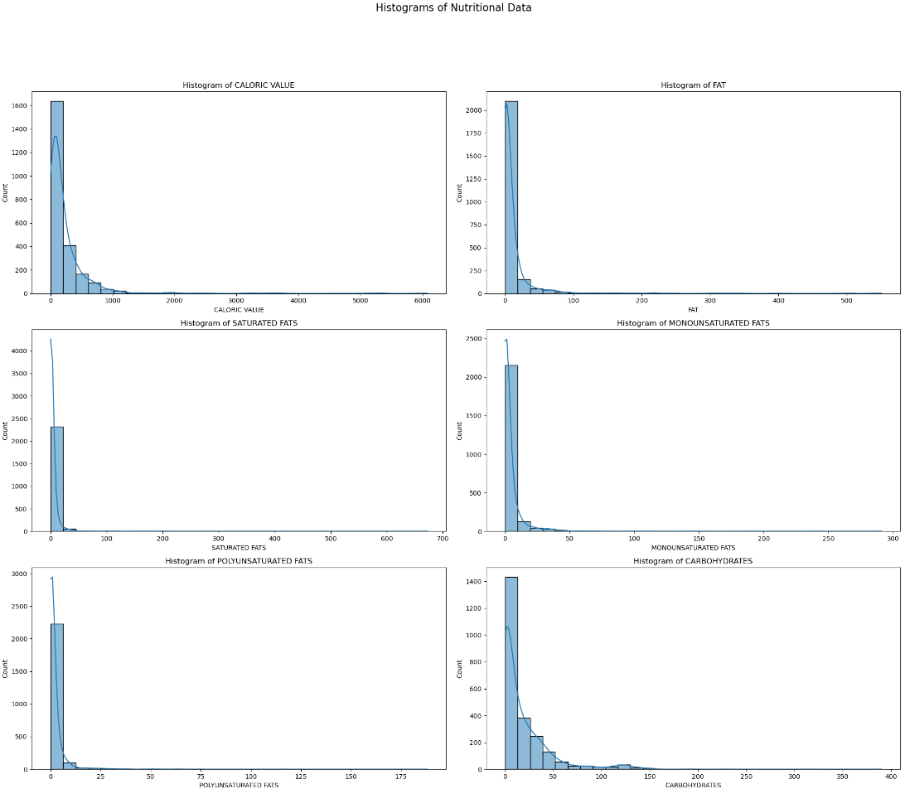
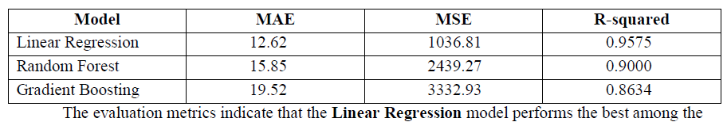
Predictive Analysis
Linear Regression was chosen as the best model due to its simplicity and high accuracy.
The model shows strong predictive power with low error rates (MAE, MSE) and high R-squared values.

Slide 14
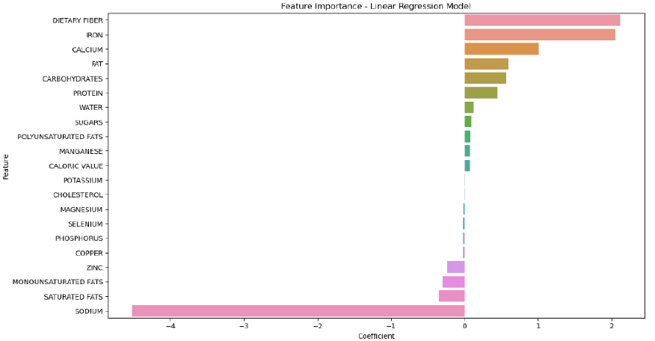
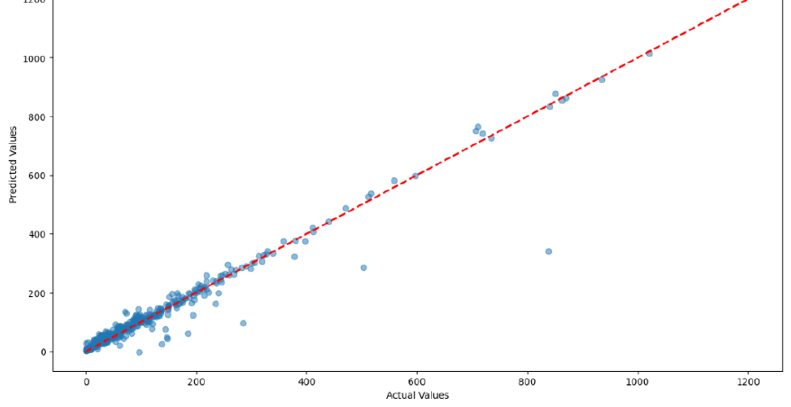
Model Interpretation
Feature importance plot identifies which nutritional factors have the most significant impact on health outcomes.
The scatter plot of actual vs. predicted values demonstrates the model’s accuracy in predicting nutritional density.

Slide 15
Conclusion
Key findings indicate that caloric value, fat, and protein are the most significant predictors of nutritional density.
The analysis highlights important dietary trends that can inform public health recommendations and policies.
Addressing these findings can help improve dietary guidelines and reduce the risk of chronic diseases.

Slide 16
Recommendations and Future Work
Recommendations:
Regularly update datasets to reflect current food consumption trends.
Include additional demographic variables for a more comprehensive analysis.
Employ more sophisticated models for better predictive accuracy.
Future Work:
Expand research to explore more complex interactions between nutritional components and health outcomes.
Apply findings to design personalized dietary plans and public health interventions.

Slide 17

Thank you for attending the presentation. Feel free to ask any questions you have.

